Slide 1
Making the “perfect” game
Raj Mohammad - EPQ

Slide 2

Contents of This Presentation
Inspiration
Research
Survey
Development of game
Evaluation

Slide 3
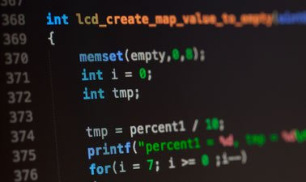
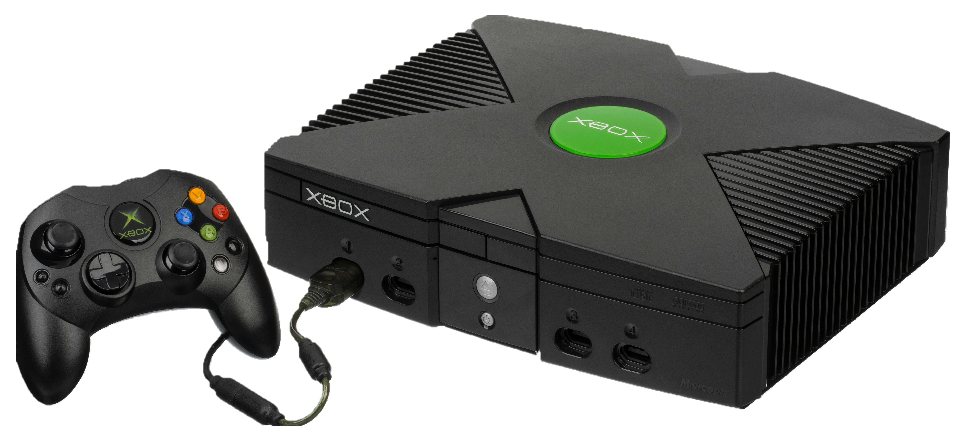
Inspiration behind project
Game Development

Slide 4
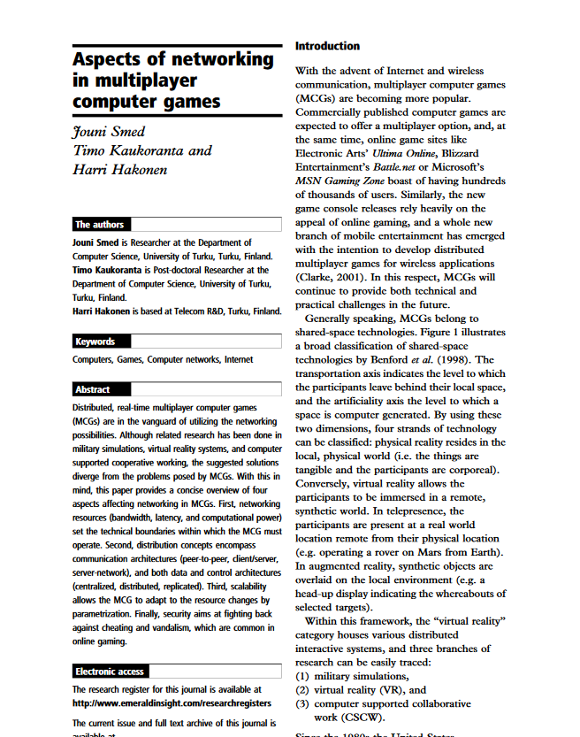




Research - Sources

Slide 5
Research
What makes a perfect game?
Nothing can be added to make it better
Can you have a perfect game?
No
What can we do instead?
Target a specific audience

Slide 6
Research
Globally popular games
Game engine/Framework
Exemplar game

Slide 7
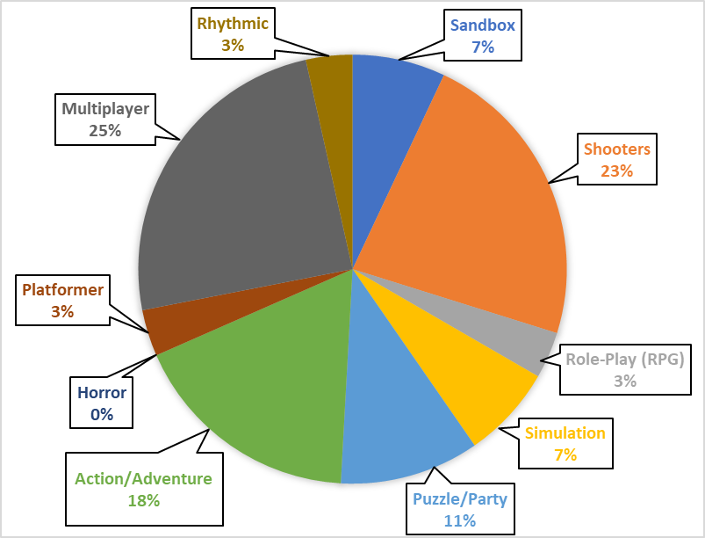
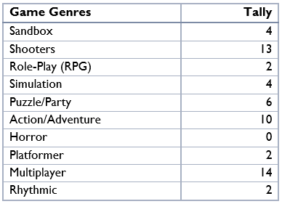
Survey
What is the most popular game genre at King’s Maths school?

Slide 8
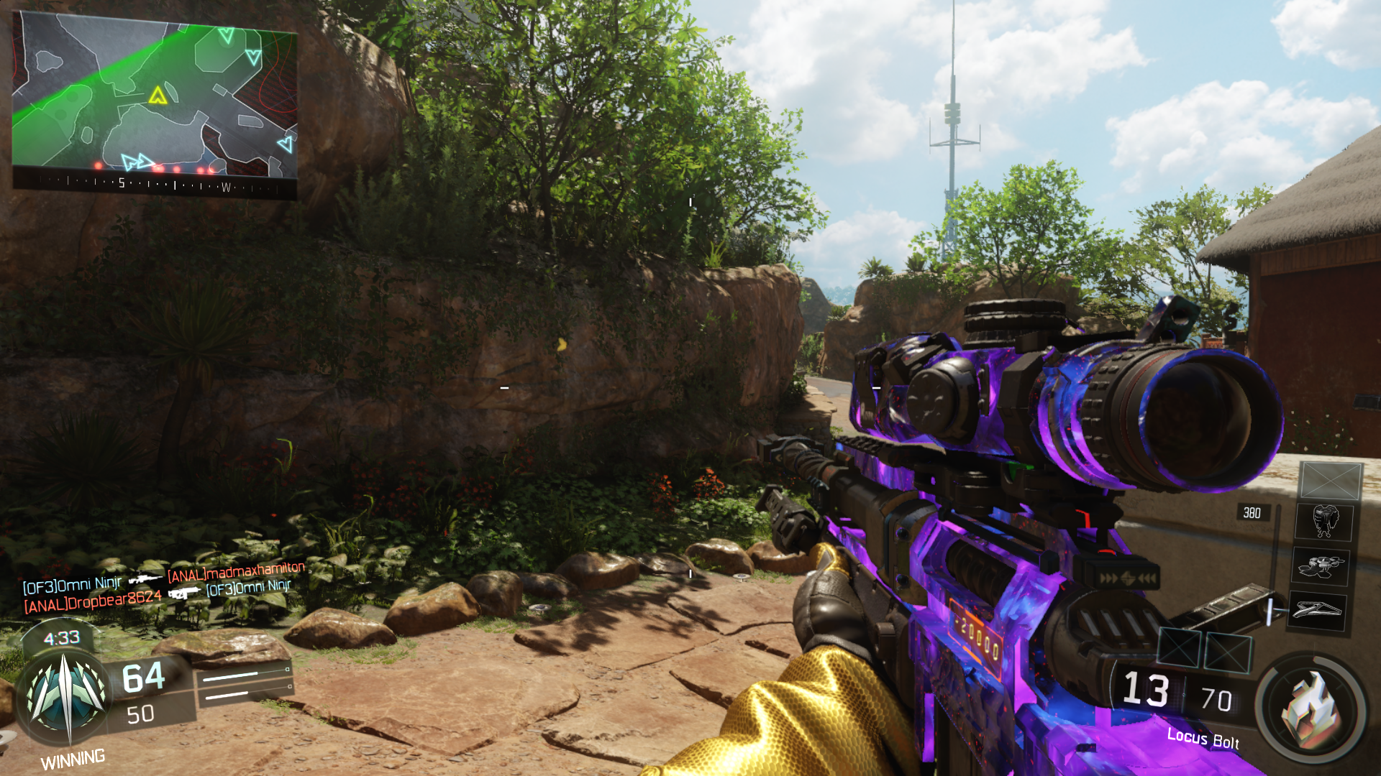
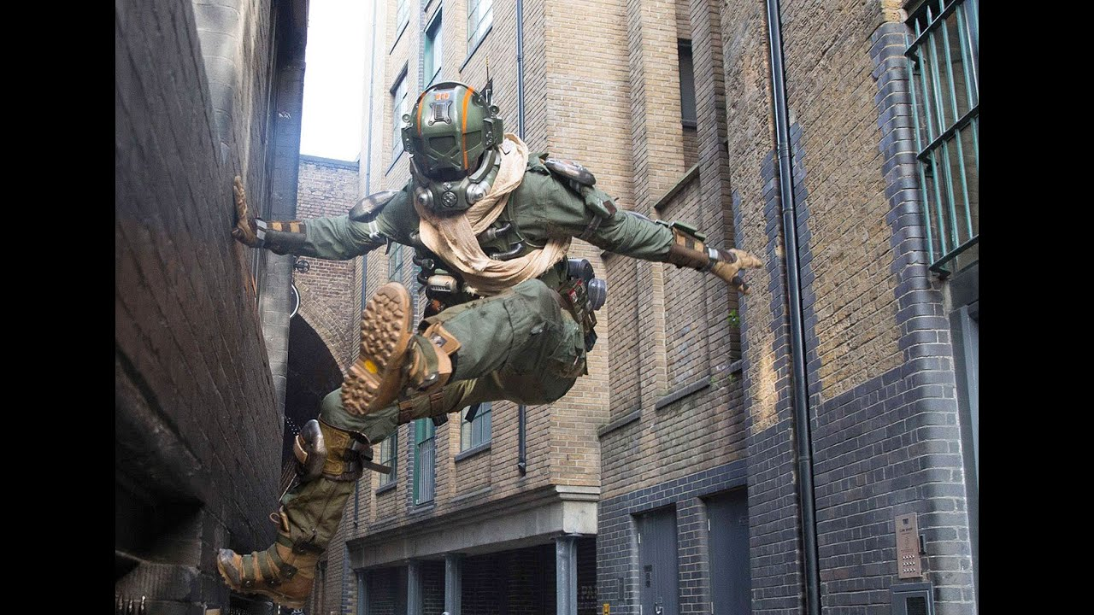

Survey - Decision
Type of Game
Selection of Game Engine
Key Mechanics
First-person, Multiplayer shooter
Unity
Wall-running and mantling

Slide 9
Timeline - Multiplayer
Initialise TCP and UDP communication
Giving players basic movement mechanics
Bug fixing, create pickups and projectiles
Setup classes to handle sending/receiving of data
Move server from local to remote

Slide 10
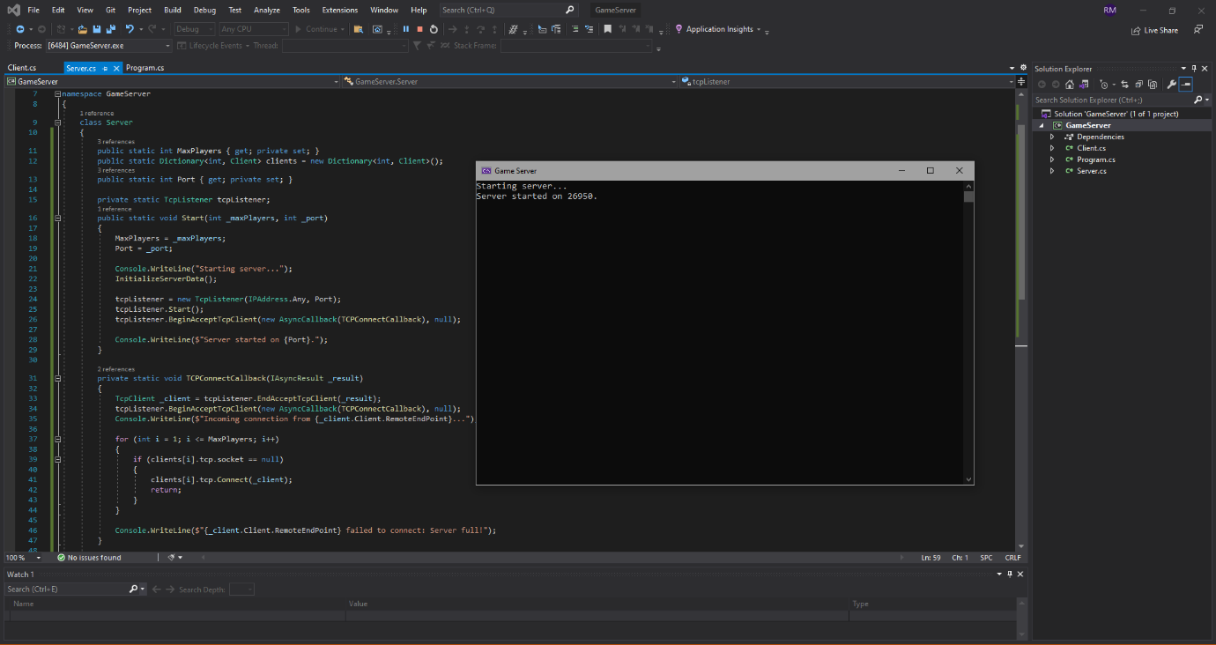

Slide 11
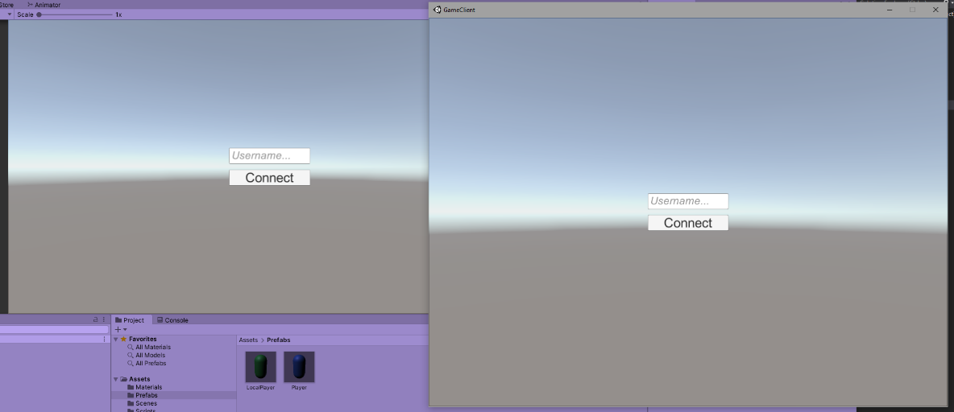

Slide 12
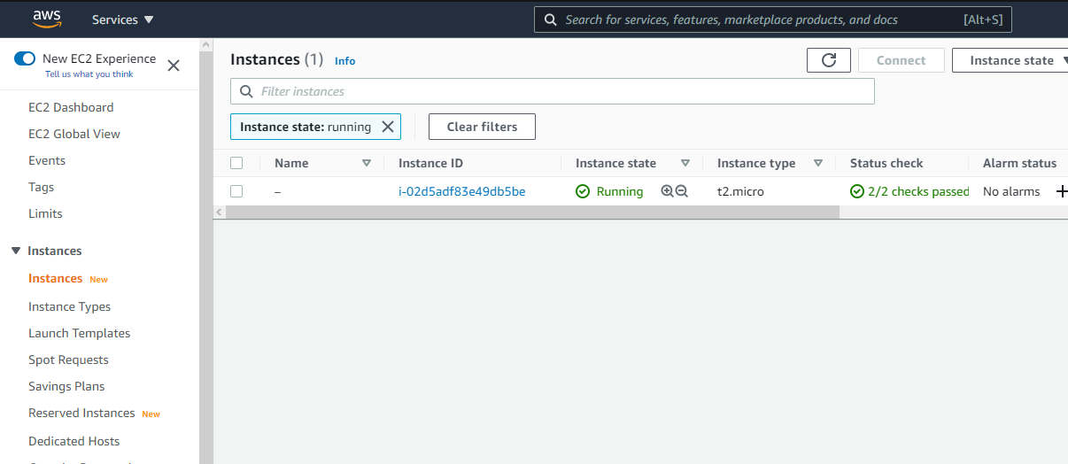

Slide 13
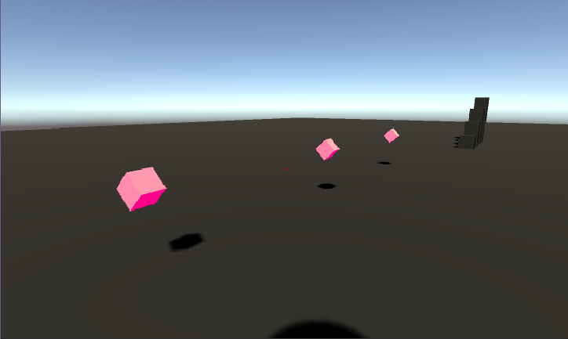
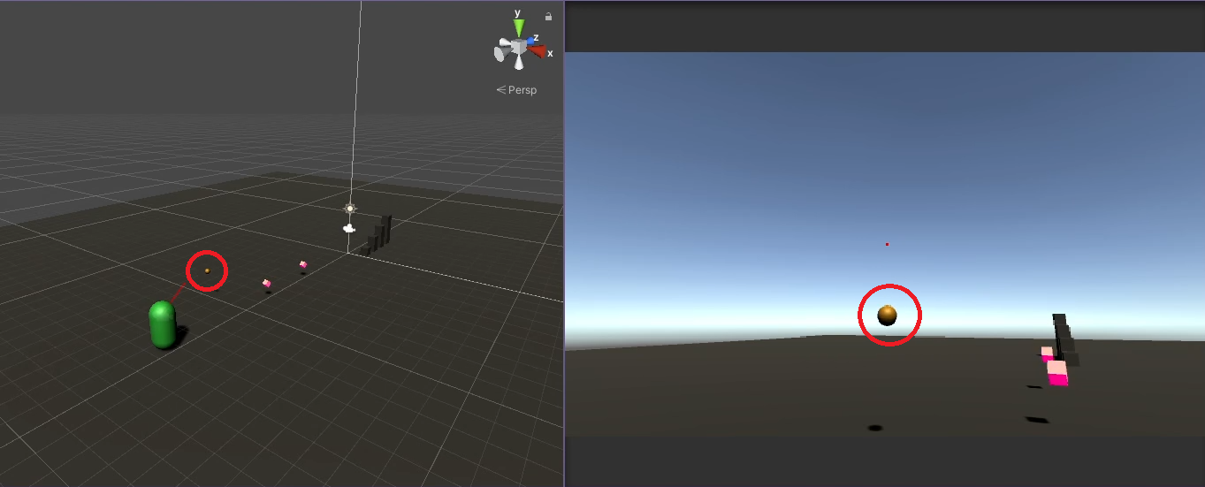

Slide 14
Timeline
Making a more sophisticated movement mechanic
Adding gunplay
Game Logic
Adding mantling and wall-running
Map Design

Slide 15
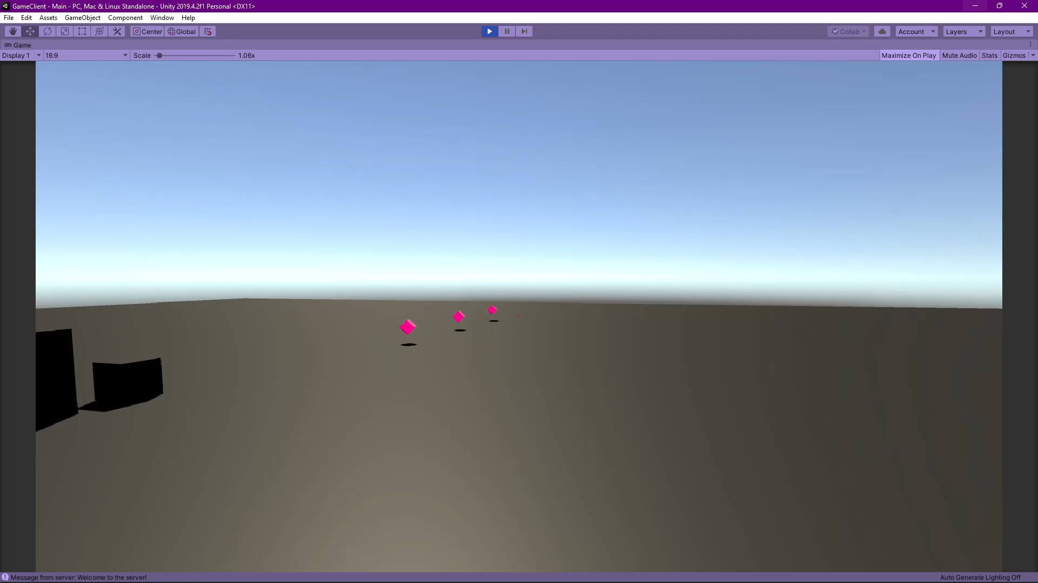
Movement (Before)

Slide 16
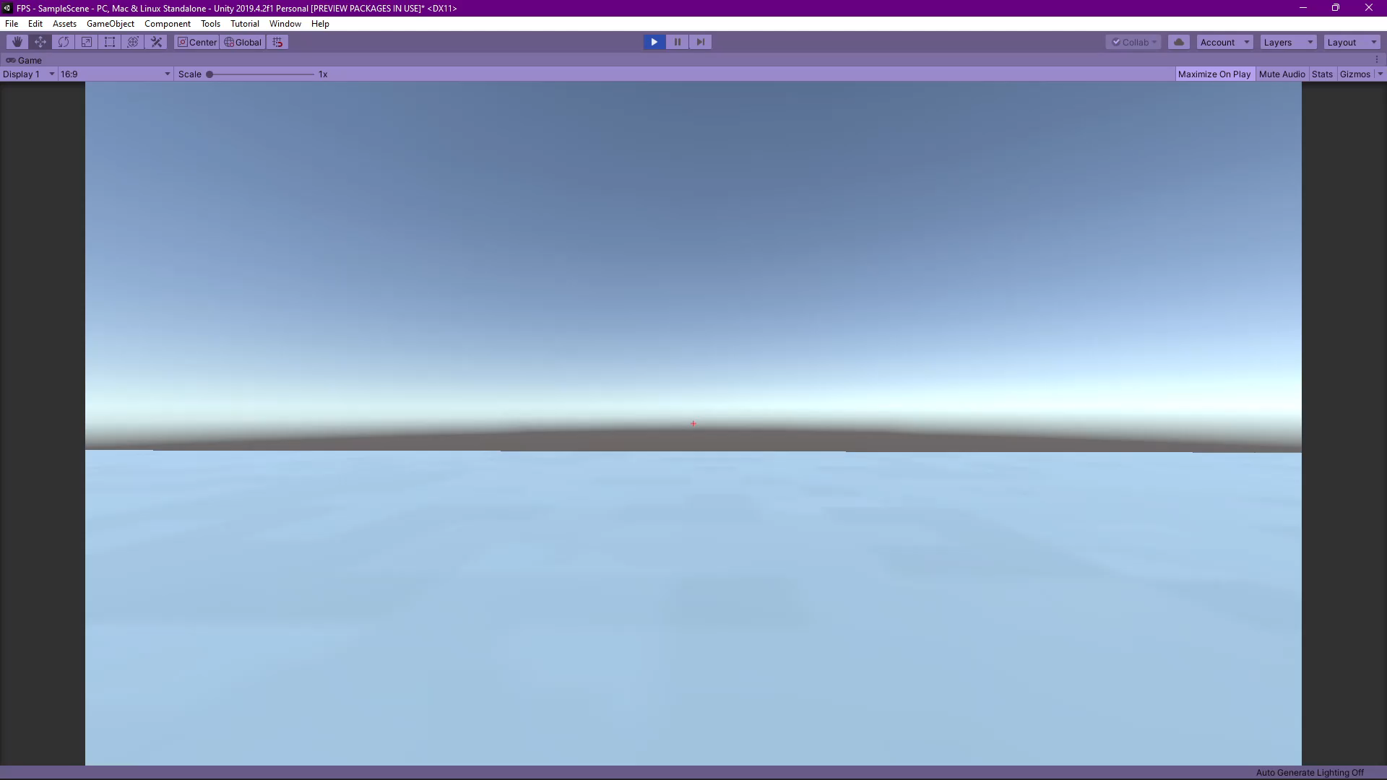
Movement (After)

Slide 17
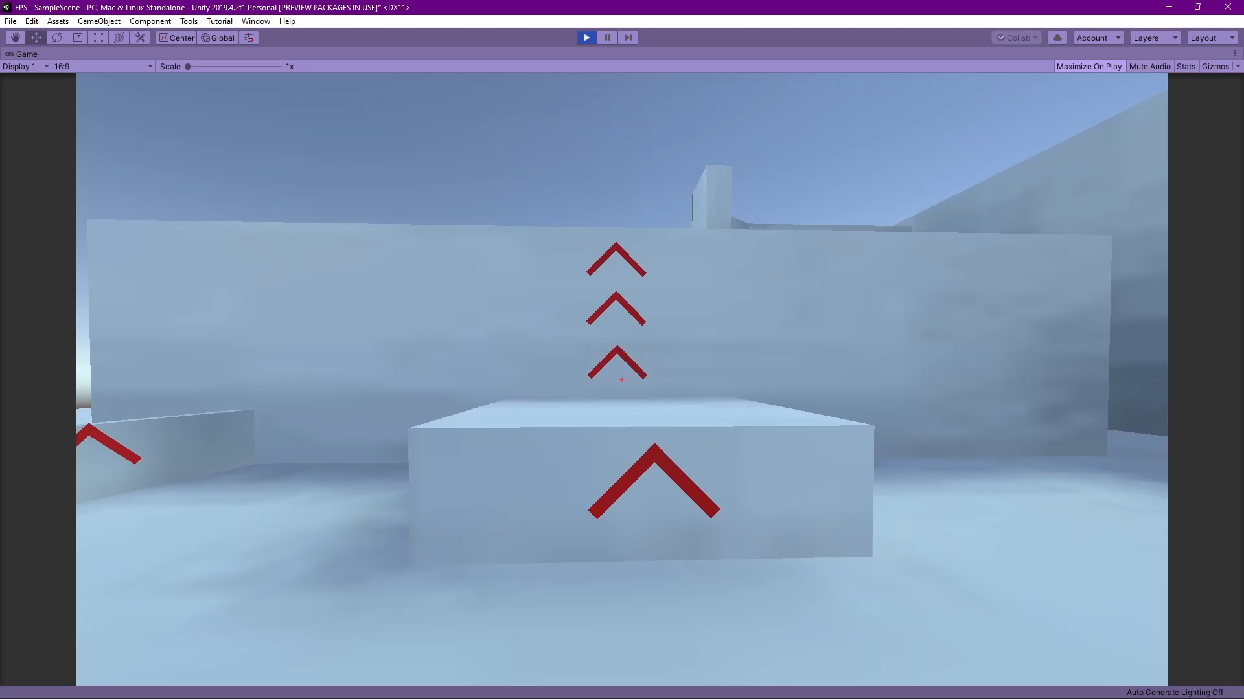

Slide 18
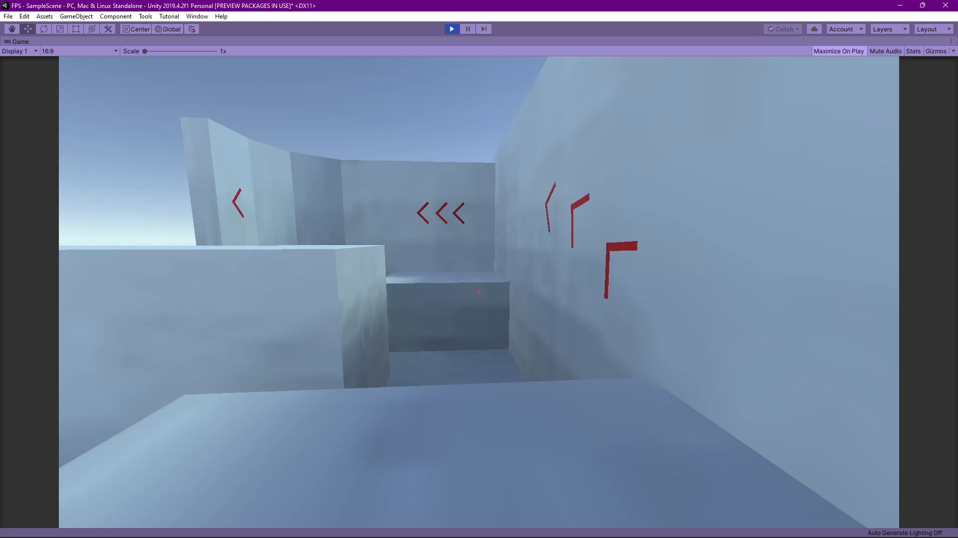

Slide 19
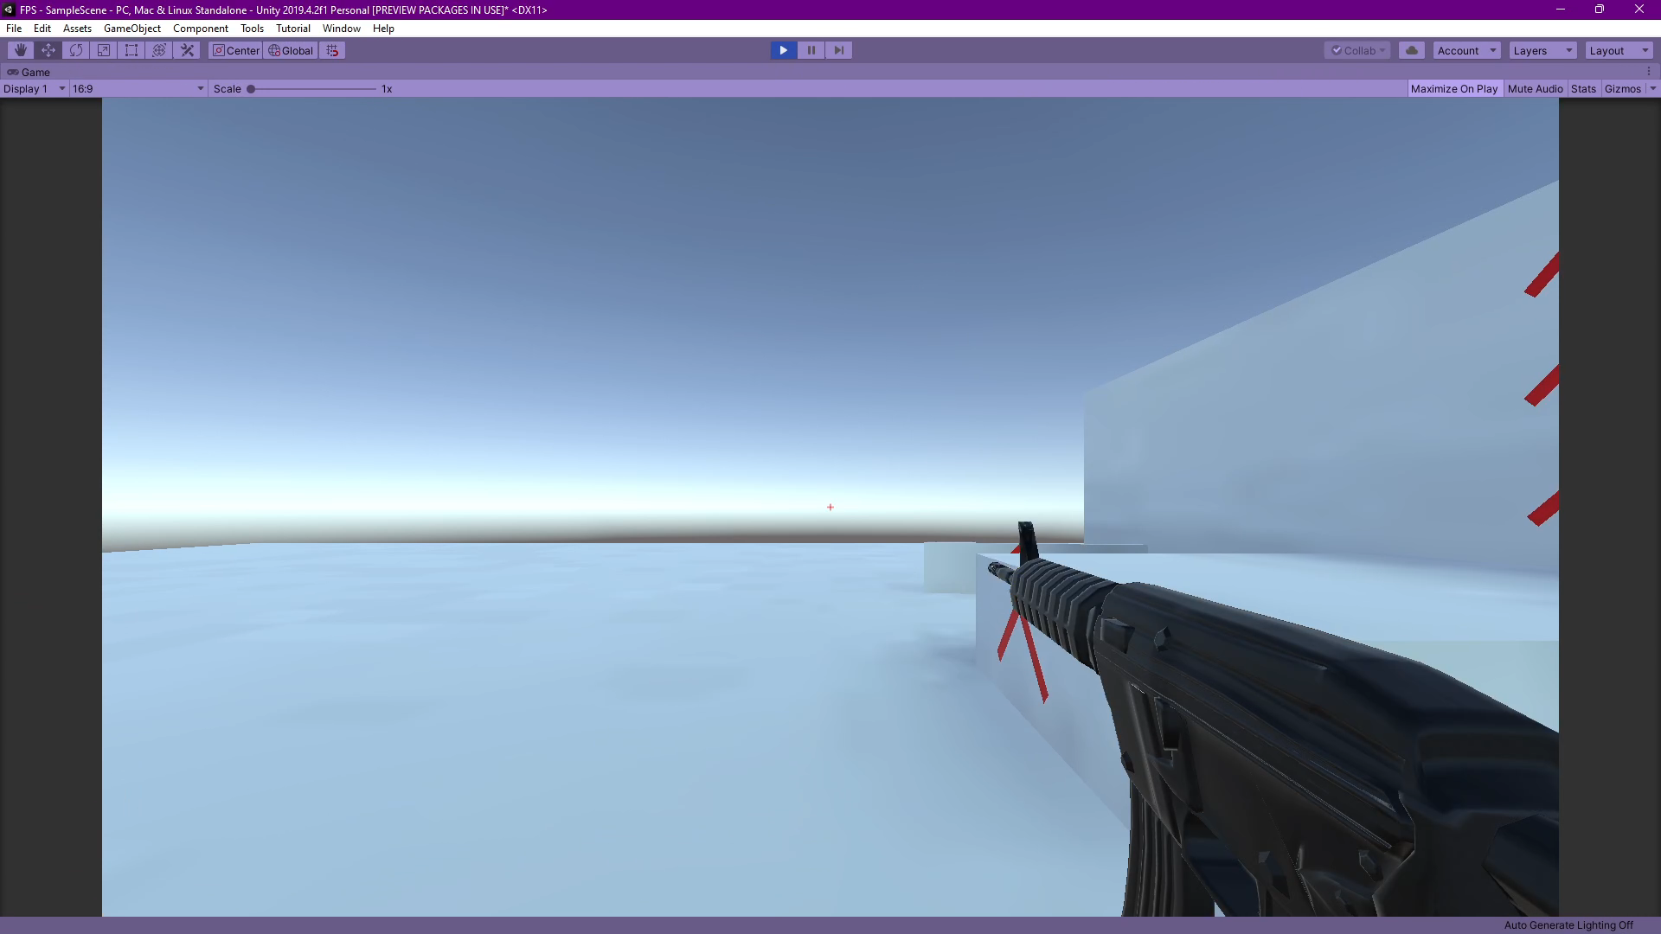

Slide 20
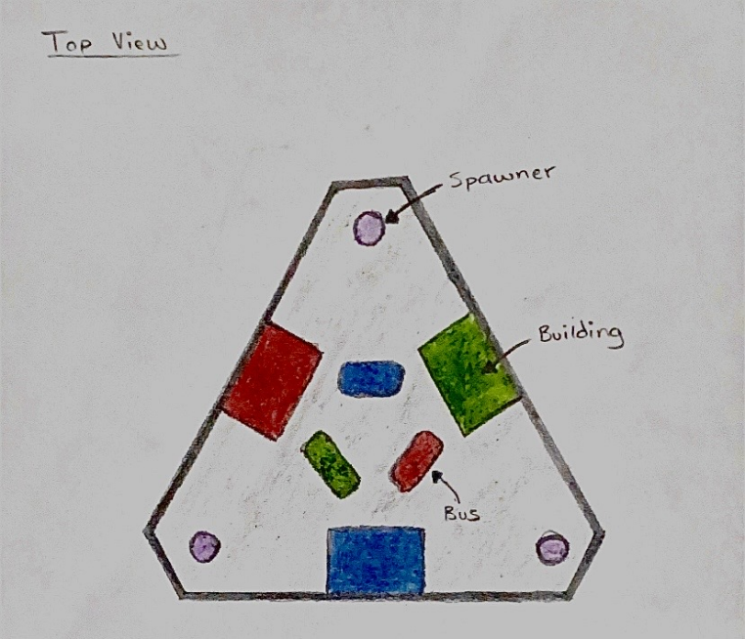
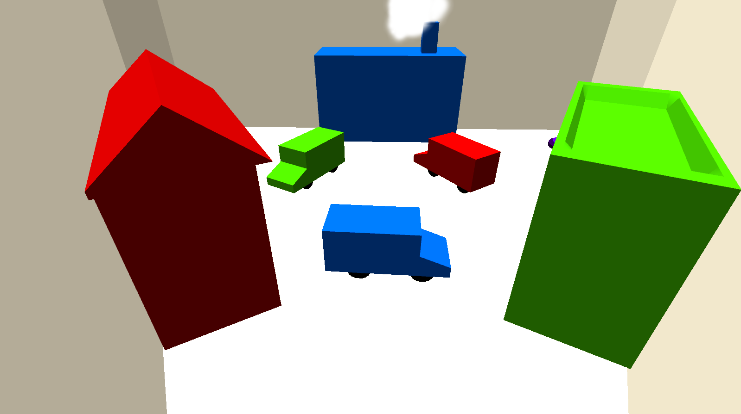

Slide 21
Evaluation
Success 1
Success 2
Success 3
Able to create a (functioning) game
Feedback was 92.6% positive
Multiplayer
Challenge 1
Challenge 2
Challenge 3
Not many features were added
3D Models taken from external sources
Time was not sufficient

Slide 22
Questions

Slide 23
Thanks for listening

